Slide 1


Diversity-Related Projects in an Introductory Statistics Course
July 11, 2018
Kyoto, Japan
Kirsten Doehler (Associate Professor of Statistics)
Laura Taylor (Associate Professor of Statistics)

Slide 2
Outline
Project History
SNAP Data
Project Goals and Details
⬥ Project 1  Project 2  Presentation
Findings related to Diversity Inventory and Reflection Questions
Conclusions

Slide 3
Project History
First iteration of project came from a Diversity Infusion Project Grant in 2013
→ We tried to find numerous diversity-themed data sets
→ Challenges in finding non-categorical data
We were asked to do a Phase II part of the project in 2015
→ Article on the “Food Stamp Challenge” motivated us
to use publicly available SNAP data (all groups used
same data set)
→ Two themes in SNAP data are socioeconomic status &
race
Notes:
For the first project, one data set had information on education and income, another had information related to whether or not somebody was in a management position and the race of each person. Another data set considered student teacher ratio and statistics related to the student body at the school.
One of the articles about the foot stamp challenge was called “A hungry Gwyneth Paltrow fails the food-stamp challenge four days in”. SNAP is meant to be supplemental or in addition to funds that a family or person may already have, but Gwyneth was trying to prove a point.

Slide 4
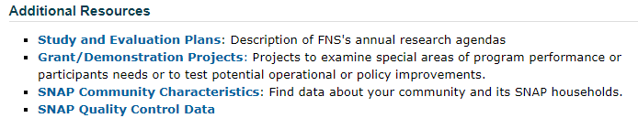
Accessing SNAP Data
United States Department of Agriculture Food and Nutrition Service. (2017). Research.
https://www.fns.usda.gov/ops/research-and-analysis

Slide 5
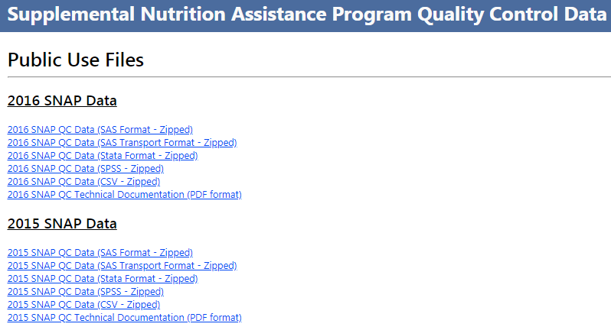
Accessing SNAP Data

Slide 6
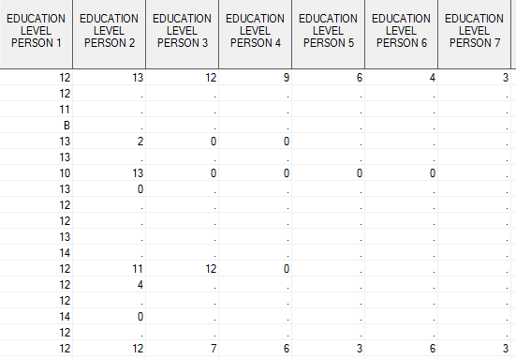
Raw SNAP Data

Slide 7
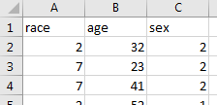
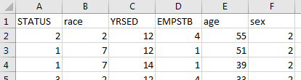
Project SNAP Data

Slide 8
Project SNAP Data
Contains all SNAP recipients (children and adults)
Contains head of household SNAP recipients
Notes:
ADDED

Slide 9
Project Goals
Students will… | P1 | P2 | Pres.
… recognize and evaluate any preconceived notions on the race of SNAP recipients and connect the trends in the data to larger population trends. | ✓
… formulate their own question about real data that can be answered using methods learned in the course. |  | ✓
… gain experience working with real, large, raw data sets. | ✓ | ✓
… select an appropriate analysis method for quantitative or categorical data. | ✓ | ✓
… perform statistical analysis using statistical software. | ✓ | ✓
… communicate statistical results in writing to a general audience. | ✓ | ✓
… familiarize themselves with the basic provisions of SNAP benefits and develop a meal plan that meets budgetary restrictions. |  |  | ✓
… communicate statistical results orally to a general audience. |  |  | ✓

Slide 10
Project 1 Details
Students work in teams using a SNAP data set with n=500 responses.
Data contains the variables: race, age, and sex
The research question is to analyze the race variable for the SNAP data.
Students use confidence intervals for proportions
Comparisons to population demographics are made.
Project 1 results in a written report.
Notes:
ADDED
Comparisons to population demographics are made --- discuss how they are similar and this can dispel some myths students might have about who receives these benefits.

Slide 11
Project 1 Details
Some challenges:
The variable race is coded 1-22 to represent 22 distinct race/ethnicity categories.
Students are asked to condense these categories into 6 broader race categories.
Students must use the code book to understand the data, e.g., 2 = Not found on application
14 = (Hispanic or Latino) and Asian
8 = (American Indian or Alaska Native) and white
Some students incorrectly interpreted the data as percent of population with each race (as opposed to percent of SNAP recipients of that race).
Notes:
ADDED

Slide 12
Project 2 Details
Students work in teams using a SNAP data set with n=500 responses.
Data contains the variables: status of benefits, race, years of education, employment status, age, and sex
Students design their own research question.
Generally students could work with ANOVA, Chi-Squared Tests, Confidence Intervals for Proportion, or Regression
Project 2 results in a written report.
Notes:
ADDED

Slide 13
Project 2 Details
Some challenges:
Several variables are coded in the data and require referencing a code book.
Students have similar interpretation issues as Project 1.
Students struggle to determine what analysis methods to use for the questions they ask.
Notes:
ADDED

Slide 14
Presentation
The presentation has two components:
Present results of Project 2.
Present a meal plan for their group (family unit) for one week under SNAP benefit requirements.
- Must plan for a breakfast, lunch, and dinner each day.
- For 2018, the average monthly benefit is about $456 for a family
of 4 (source: “A Quick Guide to SNAP Eligibility and Benefits”
from the Center on Budget and Policy Priorities website)
As part of the research study, students reflected on the meal plans they had made and general challenges for individuals on SNAP benefits.

Slide 15
Presentation
Some challenges:
A few students saw the meal plan budget as a challenge to come under budget. This trivialized the challenges of providing meals for a family on a SNAP benefits budget.
Students are unfamiliar with the cost of groceries.
Recommendations:
Have students do research on SNAP eligibility
Have students read articles on food insecurity and/or challenges of individuals living in poverty or lower-income households

Slide 16
Research Methods
Pre/Post M-GUDS short form (M-GUDS = Miville-Guzman Universality-Diversity Short form)
Example M-GUDS item: Knowing about the different experiences of other people helps me understand my own problems better.
Example M-GUDS item: It’s really hard for me to feel close to a person from another race.
Reflection questions in post-test (after presentations were completed)

Slide 17
Research Study Demographics
48 students from the “Statistics in Application” course participated in the study and completed both the pre- and post-inventories
28 (58.3%) females and 20 (41.7%) males
40 (83.3%) identified as Caucasian, 3(6.3%) identified as African American, 1(2.1%) as Asian, 1(2.1%) as Hispanic or Latino (2.1%), and 2(4.2%) as Multiracial
Most students were not statistics majors

Slide 18
Findings related to Diversity Inventory
M-GUDS short form
There was not a significant difference in the overall scores between the pre and post inventories, regardless of whether a T-test (p =0.0771) or a Signed-Rank test as utilized (p=0.1318).
1 of the 3 subscales was significant based on a T-test p-value
Subscale | Average Difference (Post – Pre) | 95% Conf. Interval (Post – Pre) | 2-sided T-test p-value | 2-sided Signed Rank Test p-value
Diversity of Contact | 0.83 | (0.02, 1.65) | 0.0454 | 0.0669
Relativistic Appreciation | 0.48 | (-0.48, 1.39) | 0.2940 | 0.4598
Comfort With Differences | 0.19 | (-0.62,1.00) | 0.6443 | 0.9458

Slide 19
Responses to Reflection Questions

Slide 20
Responses to Reflection Questions

Slide 21
Responses to Reflection Questions
What reflections do you have on the challenges
for individuals who receive SNAP benefits?”
 | Empathy for or Challenges of People on SNAP benefits | Nutritional limitations of SNAP benefits | Limitations of SNAP benefits
Responses indicative of this sentiment | 32 (66.7%) | 17 (35.4%) | 7 (14.6%)
Responses not indicative of this sentiment | 16 (33.3%) | 31 (64.6%) | 41 (85.4%)
Total Responses | 48 | 48 | 48

Slide 22
Example Responses
Student response | Theme(s)
It is so hard to imagine the struggles these people would face, given how challenging it was for our group of 6 college students to figure it out! | Empathy/Challenges
It made me realize how hard it is for people on SNAP benefits to eat healthy and to provide enough food for their family. And it really made me appreciate the money I have for food. | Empathy/Challenges, Nutritional Limitations
It's often hard to make ends meet and I have a newfound level of respect for people who have no other choice but to use SNAP benefits. | Empathy/Challenges
There was not enough money to feed us. Especially myself because I play <<a sport>> and need much more food than we had. | Limitations of SNAP

Slide 23
Conclusions
Insignificant overall M-GUDS results.
SNAP project provides an opportunity for students to work on a project which helps them gain statistical skills while simultaneously thinking critically about issues of diversity and social justice. Therefore, regardless of M-GUDS results, it’s worth trying this project with SNAP data (or other data!)
Including additional written reflections throughout the project could be beneficial.
“It is better to know some of the questions than all of the answers.” – James Thurber
Notes:
Insignificant overall results of the diversity inventory from beginning to end of the project doesn’t mean that using diversity infused activities and assignments are not useful. Statisticians are in a unique place to be able to “play in everyone’s backyard” as John Tukey has been credited with saying → the exploration of pressing topics through data. One of the many “backyards” statistics educators can and should play in is investigating social justice and diversity issues.

Slide 24



Questions?
Kirsten Doehler
Associate Professor of Statistics
Elon University
kdoehler@elon.edu
Laura Taylor
Associate Professor of Statistics
Elon University
ltaylor18@elon.edu

